Slide 1

St.Ann’s College Of Engineering And Technology
Department Of Electrical And Electronics Engineering
BATCH NO:-11
Distribution System POWER flow control by using distributed power flow controller method
PRESENTED BY:-
K.Umamaheswari (11F05A0213)
S.Ayyappa kumar (10F01A02A0)
Sk.Bilal (11F05A0223)
GUIDED BY:-
G.Chirangeevi (11f05A0208)
Mr. Y.Narayana Rao
(Associate.professor)

Slide 2
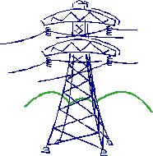
CONTENTS
AIM OF THE PROJECT
INTRODUCTION
HARMONICS
EXISTING SYSTEM
OPERATION OF STATCOM AND SSSC
FLAWS IN EXISTING SYSTEM
PROPOSED SYSTEM
DPFC PRINCIPLE AND OPERATION
DPFC CONTROL
RESULTS
CONCLUSION
REFERENCES

Slide 3
AIM
To control the flow of power in the transmission lines by using facts devices which enables independent control of active and reactive power besides improving reliability and quality of the supply.

Slide 4

INTRODUCTION
The growing demand and the aging of networks make it desirable to control the power flow in power transmission systems fast and reliably.

Slide 5
HARMONICS
Harmonics are currents or voltages with frequencies that are integer multiples of the fundamental power frequency being 50 or 60Hz.

Slide 6
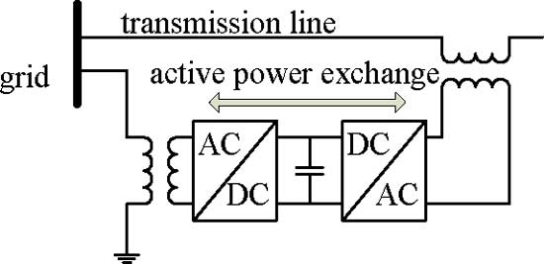
To allow bidirectional flow of active power between the series output terminals of the SSSC and the shunt output terminals of the STATCOM
The UPFC is the combination of static synchronous compensator and a static synchronous series compensator
FIG: UPFC CONFIGARATION

Slide 7
OPERATION OF STATCOM AND SSSC
The STATCOM will generate or absorbs the reactive power to regulate the voltage magnitude at the connection point. By using this we can control the voltage variations in the system.
The Static Synchronous Series Compensator (SSSC) consists of a converter that is connected in series with the transmission line. The purpose of this is to increase or decrease the overall reactive voltage drop across the line, thereby controlling the power flow.

Slide 8
FLAWS IN EXISTING SYSTEM
The components of the UPFC handle the voltages and currents with high ratting ,therefore the cost of the system is high.
Due to the common dc link inter connection a failure that happens at one converter will influences the whole system.

Slide 9
PROPOSED SYSTEM
The DPFC is able to control all system parameters. The DPFC eliminates the common dc link between the shunt and series converters.
The active power exchange between the shunt and the series converter is through the transmission line at the third-harmonic frequency.

Slide 10
FIG: DPFC CONFIGARATION

Slide 11
DPFC PRINCIPLE AND OPERATION
DPFC is achieved by combining these two approaches are First, eliminating the common dc link of the UPFC and second distributing the series converter.
The shunt converter is similar as a STATCOM, while the series converter employs the D-FACTS concept, which is to use multiple single-phase converters instead of one large rated converter

Slide 12
DPFC CONTROL
To control the multiple converts they can be used to central controller, shunt controller and series controller.
The shunt and series control are local controllers and are responsible for maintaining their own converters.

Slide 13
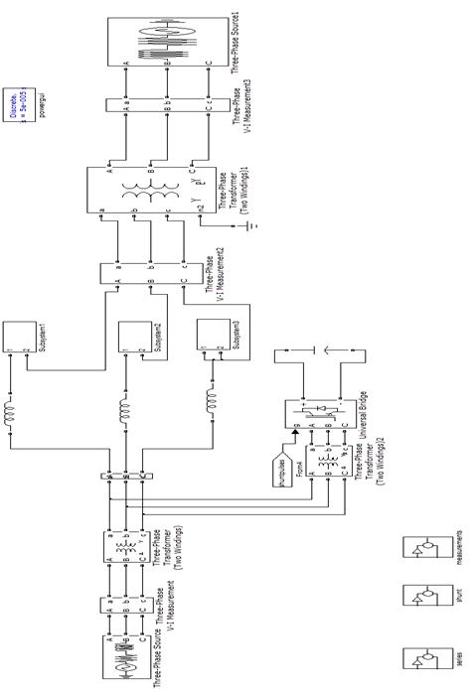
SIMULATION CIRCUIT

Slide 14
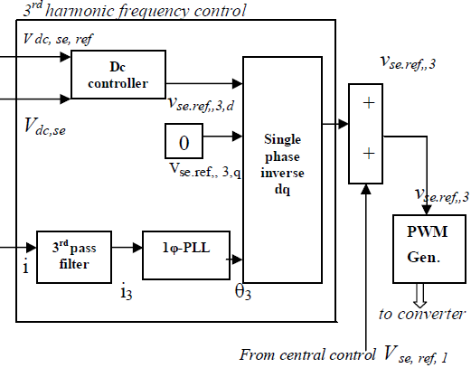
FIG: BLOCK DIAGRAM OF SERIES CONVERTER CONTROL

Slide 15
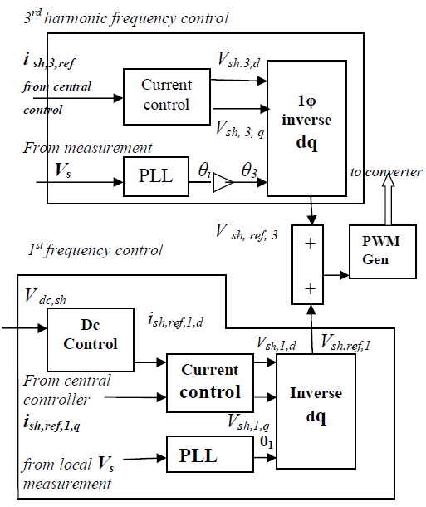
FIG: BLOCK DIAGRAM OF SHUNT CONVERTER CONTROL

Slide 16
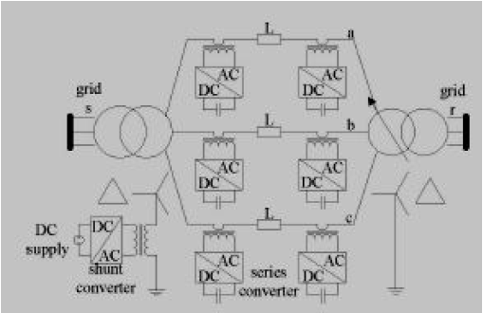
FIG. EXPERIMENTAL SET UP

Slide 17
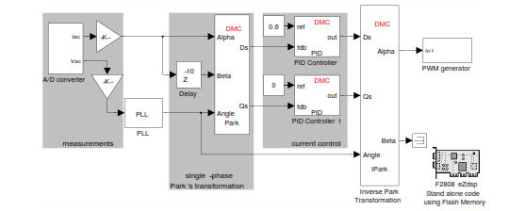
SIMULATION CIRCUIT OF SERIES CONVERTER CONTROL…

Slide 18
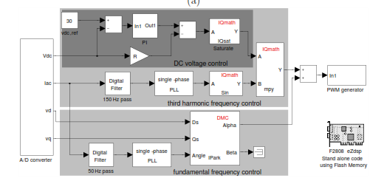
SIMULATION CIRCUIT OF SHUNT CONVERTER CONTROL…

Slide 19
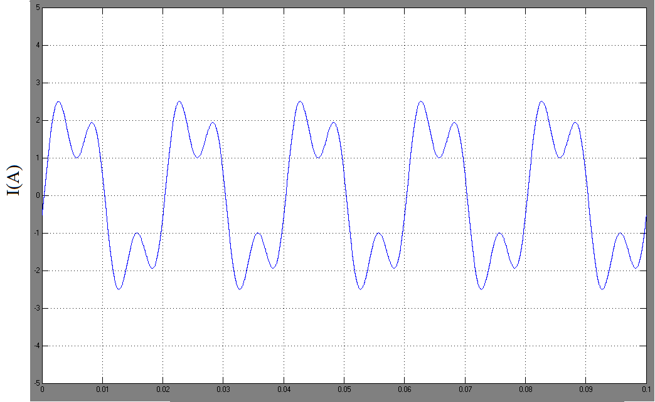
RESULTS
Time (sec)
Fig: DPFC operation in steady-state: line current

Slide 20
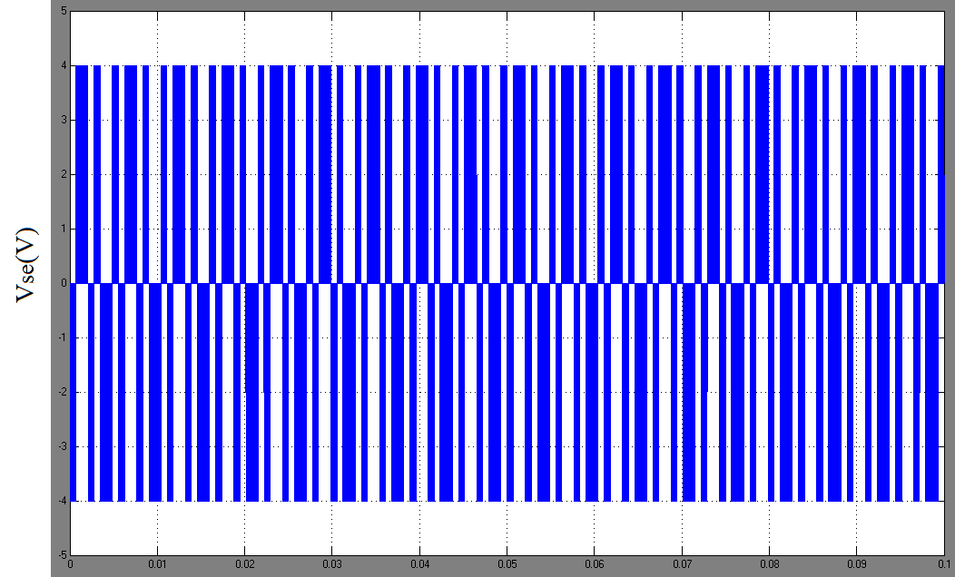
Time (sec)
Fig: DPFC operation in steady-state: series converter voltage

Slide 21
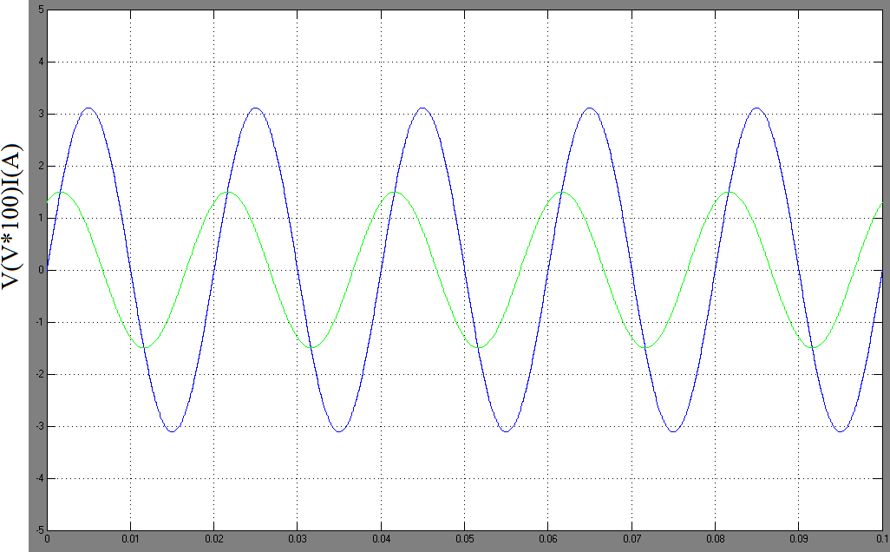
Time (sec)
Fig: DPFC operation in steady-State: bus voltage and current
at the ∆ side of the transformer.

Slide 22
CONCLUSION
In this project a new concept on modeling and simulation of DPFC is presented.
The common dc link between the shunt and series converters, which is used for exchanging active power in the UPFC, is eliminated. The reliability of the DPFC is greatly increased because of the redundancy of the series converters.
It is proved that the shunt and series converters in the DPFC can exchange active power at the third-harmonic frequency and the series converters are able to inject controllable active and reactive power at the fundamental frequency.

Slide 23
REFERENCES
[1] Y.-H. Song and A. Johns, Flexible ac Transmission Systems (FACTS) (IEE Power and Energy Series), vol. 30. London, U.K.: Institution of Electrical Engineers, 1999.
[2] N. G. Hingorani and L. Gyugyi, Understanding FACTS : Concepts andTechnology of Flexible AC Transmission Systems. New York: IEEE Press, 2000.
[3] L.Gyugyi, C.D. Schauder, S. L.Williams, T. R. Rietman,D. R. Torgerson,andA. Edris, “The unified power flowcontroller:Anewapproach to power transmission control,” IEEE Trans. Power Del., vol. 10, no. 2, pp. 1085–1097, Apr. 1995.
[4] A.-A. Edris, “Proposed terms and definitions for flexible ac transmission system (facts),” IEEE Trans. Power Del., vol. 12, no. 4, pp. 1848– 853, Oct. 1997.
[5] K. K. Sen, “Sssc-static synchronous series compensator: Theory, modeling, and application,” IEEE Trans. Power Del., vol. 13, no. 1, pp. 241–246, Jan. 1998.

Slide 24


Thank
You

Slide 25

QUERIES

